Slide 1


Extending Maximo Records with views
Jade Warren | Principal Systems Analyst |
“Great things are not done by impulse, but by a series of small things brought together”
Vincent Van Gogh

Slide 2
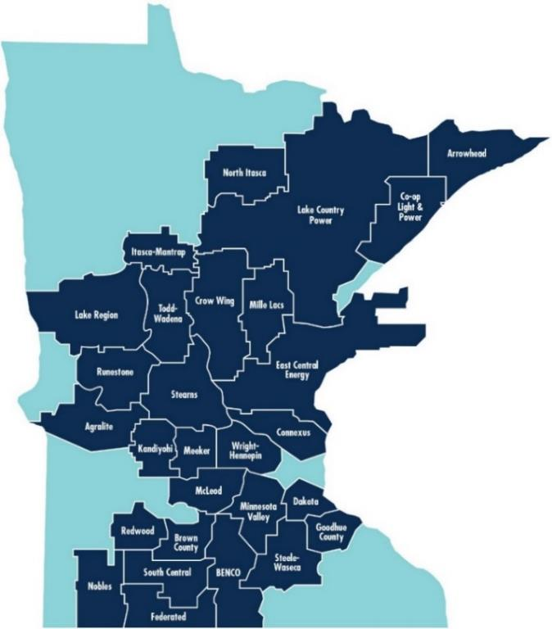
Great River Energy
27 member-owner cooperatives
715,000 members
$3.9 billion total assets
$981 million revenue
Competitive rates, stable forecast
4,800+ miles of transmission lines
3,000+ MW generation
~300,000 Maximo assets
Maximo 7.6.1.3 on Tivoli13 skin
Notes:
and facilitates it in companies that have a large number of suppliers where the procurement service would have to send a huge number of emails, make numerous phone calls, compare prices, etc. Thus, the Client visits the supplier’s portal via Maximo, makes a purchase electronically and all data are entered into Maximo.

Slide 3


Agenda
Process background (2 minutes)
Maximo Views
Create JOIN Views
Tying it all together
Wrap-up / questions
Jade Warren
Principal Systems Analyst
19 years Maximo experience
Service Management focus
Beekeeper

Slide 4

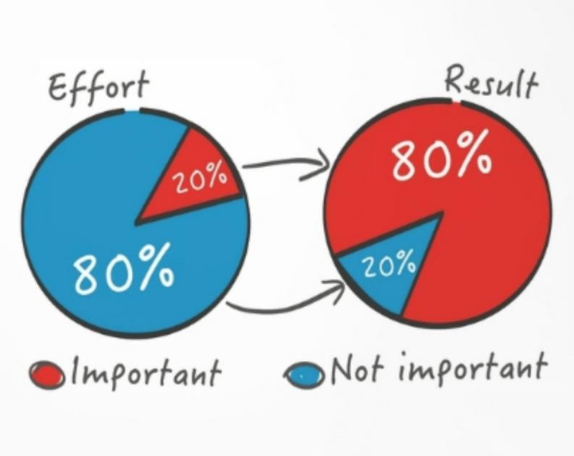
The Power of Curiosity
Notes:
and facilitates it in companies that have a large number of suppliers where the procurement service would have to send a huge number of emails, make numerous phone calls, compare prices, etc. Thus, the Client visits the supplier’s portal via Maximo, makes a purchase electronically and all data are entered into Maximo.

Slide 5
Business Process Requirements
Project: move Transmission clearances into Maximo
Architecture:
Challenges:
New record type (WORKORDER)
MANY additional fields
New Maximo application (Clearances)
Width of the WORKORDER table
Business logic (conditions, escalations, scripting)
User interface smoothness

Slide 6
Maximo VIEWS
 | STANDARD | DATABASE | JOIN
Description | Subset of existing Maximo table | SQL SELECT at database level | Linking Maximo tables
Mechanism(s) | Apply view WHERE clause to existing table | Enter exact Object (name) as database view | Create child table and link to parent Use View Select for multiple sources
Input mode(s) | READ, INSERT, SAVE, DELETE | READ | READ, INSERT, SAVE, DELETE
Uses | Process-specific applications of core tables | Calculations and cross-tabs | Process-specific applications of core tables
Examples | Work order views such as WOACTIVITY Contract views Plans views (WPTOOL, WPMATERIAL, WPSERVICE) | <none> SELECT * FROM maxobjectcfg WHERE isview = 1 AND imported = 1; | WORELEASE WMASSIGNMENT IT asset tables

Slide 7
Maximo VIEWS
Existing Maximo table (parent)
+
Configured child table
=
Configured Maximo VIEW
Maximo table
  Attributes
  Auditing
  Classes
New table
  Attributes
  Auditing
New view
  Attributes
  Auditing
  Classes
  Domains

Slide 8
Creating Maximo JOIN VIEWS
Create child object
Create index
Create view
Additional fields
Primary key fields from parent
Same LEVEL as parent
Cannot be the UID (BIGINT)
Use primary key fields from parent
Same as parent…
  Class
  Service
  Level
Main object?

Slide 9
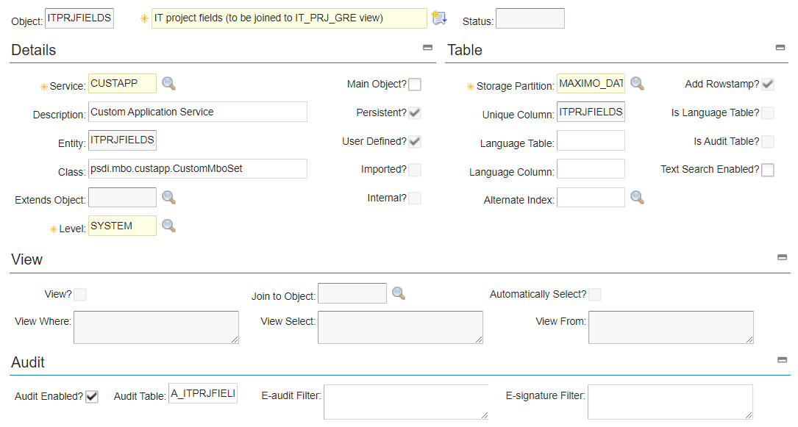
Create child object
Database configuration
New object
Same LEVEL as parent object
Audit-enabled?

Slide 10
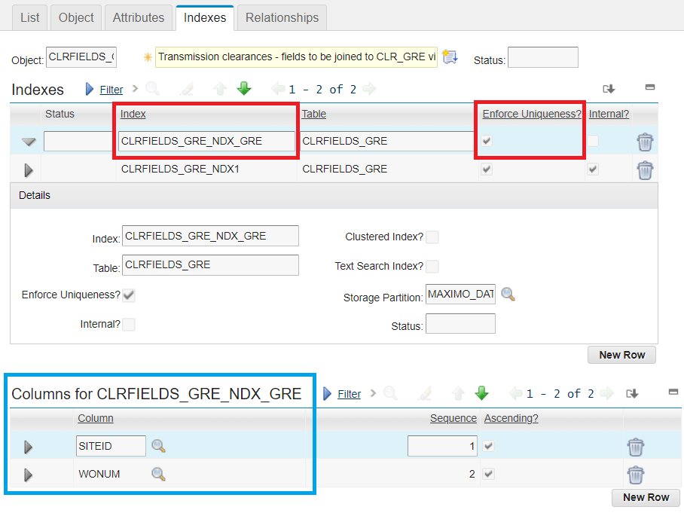
Create child object – index
Index name
Enforce uniqueness
Add all primary key columns
In same order?...
SAVE + DBCONFIG

Slide 11
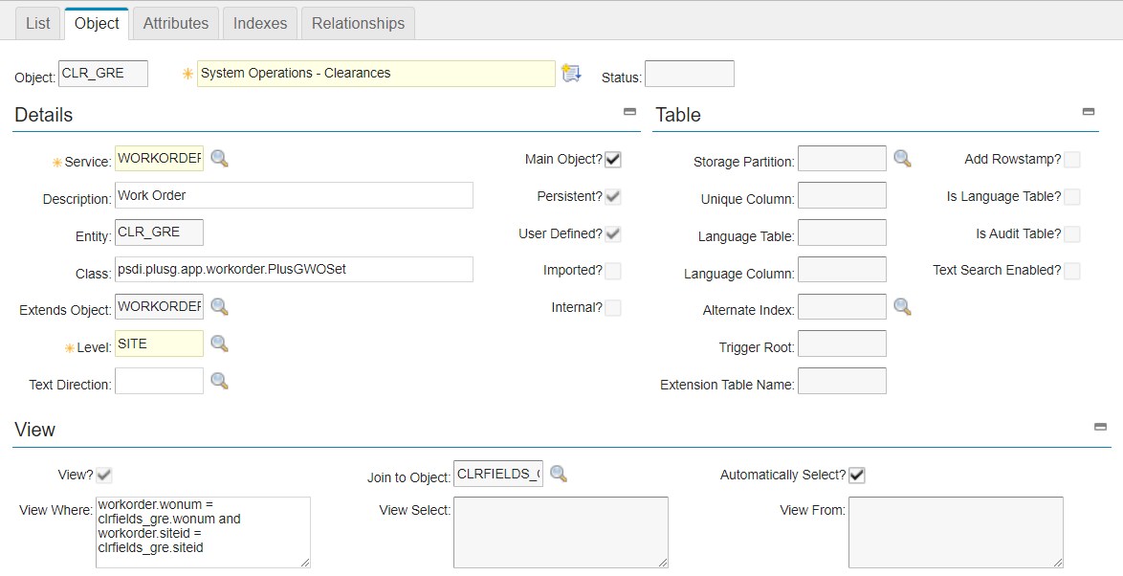
Create view
Same service as parent
Same class as parent
Same level as parent

Slide 12
Create view
Main object?

Slide 13
Create view
Specify the parent
Specify the child
Automatically select

Slide 14
Create view
Maximo will build the WHERE clause using the index

Slide 15
FINISHING UP & DEMO
Configure attributes
DBCONFIG
View is available!
Classes
Domains
Labels
etc…
Applications
Automation scripts + launch points
Escalations
Workflows

Slide 16




Thank you
Ask us
a technical question:
Watch
previous webinars:
Thank You to our Partners:
maxtech@bpdzenith.com
www.bpdzenith.com/na/maxtech/
Join our LinkedIn Group | MaxTECH – Maximo Technical User Group

