Slide 1

Custom applications using just configuration: Part 2
Enhancing an Application to Request New Items and Inventory in Maximo
Stephen Hume| Maxino Principal Consultant |

Slide 2

Introduction
Recent Projects:
Maximo SME for Conversion from Asset Suite to Maximo
Re-engineering of MOC process in Maximo
Confined Space Permit Application in Maximo
Safe Work Permit Application in Maximo
Maximo Security and System Support – Hypercare
Maximo Training – 2000 end users
Upgrade to MAS 8 Planning and health check
Maximo HSE (Incidents) Configuration and Implementation
Maximo Supply Chain Improvements Project
Design integration between Fastenal and Maximo
Upgrade to 7.6.1.3
Implementation of Solar Farms in Maximo
Stephen Hume
Maximo Principal Consultant
Stephen has accumulated more than two decades of experience working with Maximo and has served as the former president of the Canadian Maximo User Group.
He is currently the Maximo Practice Director/Principal Consultant at Sheffield Scientific LLC.

Slide 3
Overview
On a recent project, our customer requested the creation of an application in Maximo to allow end users to request the creation of a new Item in the Item Master and Inventory.
After implementing the original design which was to allow the user to request the creation of one item/inventory record at a time, it soon became apparent that this would result in a burden on the reviewers and approvers. They would be receiving a bunch of workflow assignments to review and approve the inventory requests, especially after a plant turn-around and the usual spare parts that might be left over from that effort.
Make is simpler:
Allow the user to add as many items as they need to a single inventory request.
Add any and all items which are created to the spare parts list for a single asset or a list of assets.
Allow the addition of item images to the multi-line inventory request.
Separate out the item details to a new table instead of further configuring the Ticket Object.
Notes:
and facilitates it in companies that have a large number of suppliers where the procurement service would have to send a huge number of emails, make numerous phone calls, compare prices, etc. Thus, the Client visits the supplier’s portal via Maximo, makes a purchase electronically and all data are entered into Maximo.

Slide 4
New Database Table
Create a new table called SSINVRMULTI (SS is the Sheffield Scientific Prefix, so you can change it to your own prefix)
Attribute | Description | Type | Length | Scale | Primary Column | Required | Domain
CLASS | Class of the request (SR) | UPPER | 25 | 0 |  | N
DESCRIPTION | Description | ALN | 50 | 0 |  | N
DESCRIPTION_LONGDESCRIPTION | Description_longdescription | LONGALN | 32000 | 0 |  | N
HASLD | Hasld | YORN | 1 | 0 |  | Y
LOCATION | Location | UPPER | 30 | 0 |  | N | SSLOCATION
ORGID | Organization | UPPER | 8 | 0 |  | N
SITEID | Site | UPPER | 8 | 0 |  | N
SS_CURBAL | Balance to be put away | DECIMAL | 15 | 2 |  | N
SS_LEADTIME | Lead time | INTEGER | 12 | 0 |  | N
SSBINNUM | Bin Number | ALN | 40 | 0 |  | N
SSCCF | Cycle count frequency | INTEGER | 12 | 0 |  | N
SSESTANNUSAGE | Estimated annual usage | FLOAT | 8 | 0 |  | N
SSESTQTYPERJOB | Estimated quantity per job | FLOAT | 8 | 0 |  | N
SSINVRMULTIID | Ssinvrmultiid | BIGINT | 19 | 0 | 1 | Y
SSISREPSPARE | Is repairable spare | YORN | 1 | 0 |  | Y
SSITEMAVAIL | Are there any to be put away | YORN | 1 | 0 |  | Y
SSITEMCOMMODITYGROUP | Item commodity group | UPPER | 8 | 0 |  | N | SSCOMMGRP
SSITEMCOST | item cost | AMOUNT | 10 | 2 |  | N
SSITEMLOC | Where is the item located | ALN | 50 | 0 |  | N
SSITEMNUM | Item which was created | UPPER | 30 | 0 |  | N
SSITEMORDER | Does it need to be ordered | YORN | 1 | 0 |  | Y
SSITEMSET | Item set | UPPER | 8 | 0 |  | N
SSMANUFACTURER | Manufacturer | UPPER | 12 | 0 |  | N | SSMANUF
SSMINLEVEL | Reorder Point | DECIMAL | 15 | 2 |  | N
SSMODELNUM | Model Number | ALN | 50 | 0 |  | N
SSORDERQTY | Order Quantity | DECIMAL | 15 | 2 |  | N
SSORDERUNIT | Order unit | UPPER | 16 | 0 |  | N
SSSLATARGET | Service level target | ALN | 25 | 0 |  | N | SS_SLATARGET
SSSTOREROOM | Store room | UPPER | 30 | 0 |  | N | SSSTOREROOM
SSTEST | Field used for Testing | ALN | 50 | 0 |  | N
TICKETID | Ticket ID of the related Inventory Request | UPPER | 10 | 0 |  | N
VENDOR | Vendor | UPPER | 12 | 0 |  | N | SSVENDOR
Note:
Domains are added so that
lookups on those fields do
not have invalid bindings.
This new table is being added
to allow for an unlimited number
of items per Inventory Request.
Notes:
and facilitates it in companies that have a large number of suppliers where the procurement service would have to send a huge number of emails, make numerous phone calls, compare prices, etc. Thus, the Client visits the supplier’s portal via Maximo, makes a purchase electronically and all data are entered into Maximo.

Slide 5
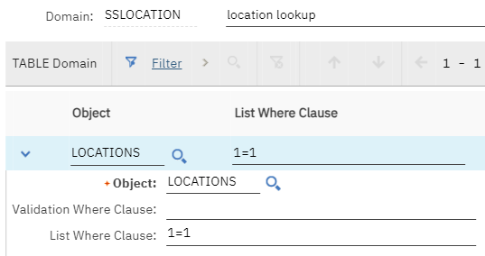
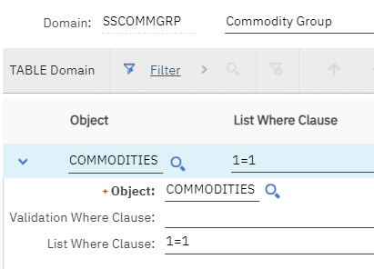
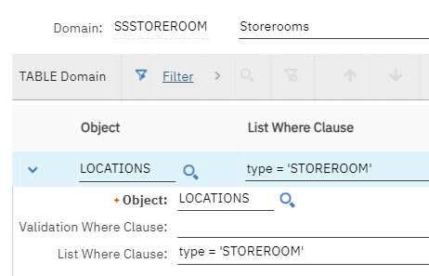
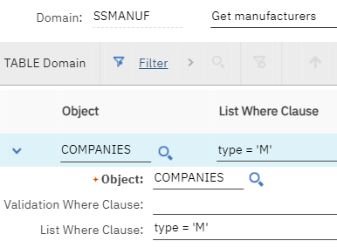
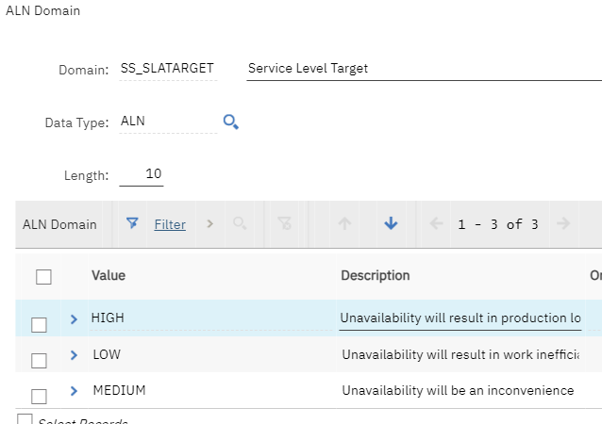
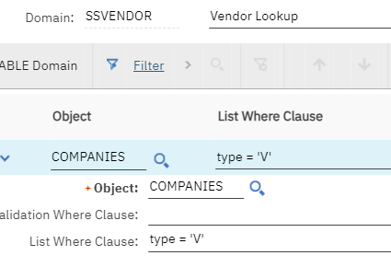
New Domains
Notes:
and facilitates it in companies that have a large number of suppliers where the procurement service would have to send a huge number of emails, make numerous phone calls, compare prices, etc. Thus, the Client visits the supplier’s portal via Maximo, makes a purchase electronically and all data are entered into Maximo.

Slide 6
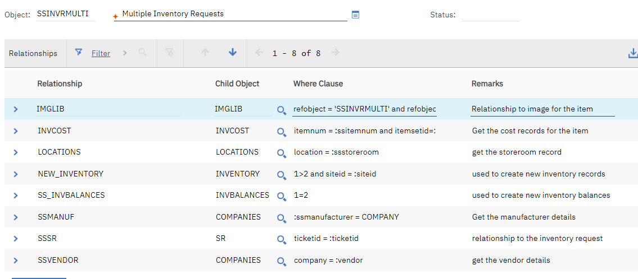
New Relationships
Notes:
and facilitates it in companies that have a large number of suppliers where the procurement service would have to send a huge number of emails, make numerous phone calls, compare prices, etc. Thus, the Client visits the supplier’s portal via Maximo, makes a purchase electronically and all data are entered into Maximo.

Slide 7
New Relationships
Object | Name | Where Clause | Child Object | Remarks
SSINVRMULTI | IMGLIB | refobject = 'SSINVRMULTI' and refobjectid = :ssinvrmultiid | IMGLIB | Relationship to image for the item
SSINVRMULTI | INVCOST | itemnum = :ssitemnum and itemsetid=:SSITEMSET and location=:ssstoreroom and siteid=:siteid | INVCOST | Get the cost records for the item
SSINVRMULTI | LOCATIONS | location = :ssstoreroom | LOCATIONS | get the storeroom record
SSINVRMULTI | NEW_INVENTORY | 1=2 | INVENTORY | used to create new inventory records
SSINVRMULTI | SS_INVBALANCES | 1=2 | INVBALANCES | used to create new inventory balances
SSINVRMULTI | SSMANUF | :ssmanufacturer = COMPANY | COMPANIES | Get the manufacturer details
SSINVRMULTI | SSSR | ticketid = :ticketid | SR | relationship to the inventory request
SSINVRMULTI | SSVENDOR | company = :vendor | COMPANIES | get the vendor details
SR | SSINVRMULTI | ticketid = :ticketid | SSINVRMULTI | list of items to be created for multi inventory request
Notes:
and facilitates it in companies that have a large number of suppliers where the procurement service would have to send a huge number of emails, make numerous phone calls, compare prices, etc. Thus, the Client visits the supplier’s portal via Maximo, makes a purchase electronically and all data are entered into Maximo.

Slide 8
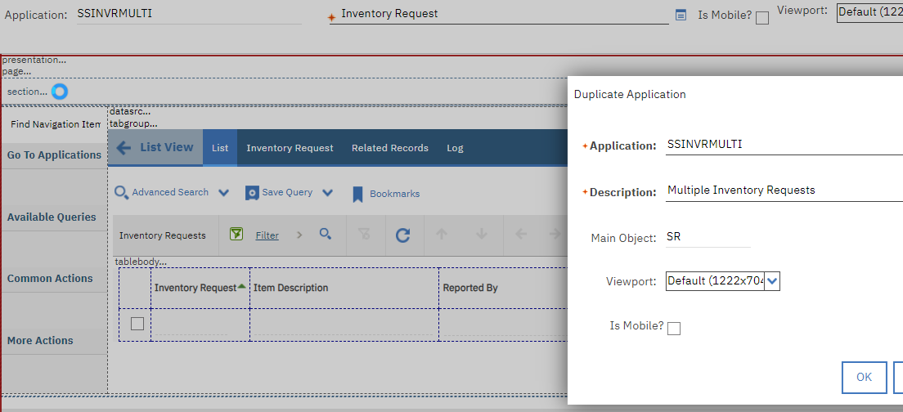
Creating the Two New Applications
The first application that will be created will be a clone of the original Inventory Request Application.
Give the new application a Name (SS_INVRMULTI)
with a description of Multiple Inventory Requests
Note:
If you are creating this application from scratch and do not have the SS_INVR application to duplicate, you can refer to the presentation from the previous MaxTECH and start with a clone of the SR application instead.
If any of you wish to receive the XML for the completed SS_INVRMULTI application, please reach out to me.
Notes:
and facilitates it in companies that have a large number of suppliers where the procurement service would have to send a huge number of emails, make numerous phone calls, compare prices, etc. Thus, the Client visits the supplier’s portal via Maximo, makes a purchase electronically and all data are entered into Maximo.

Slide 9
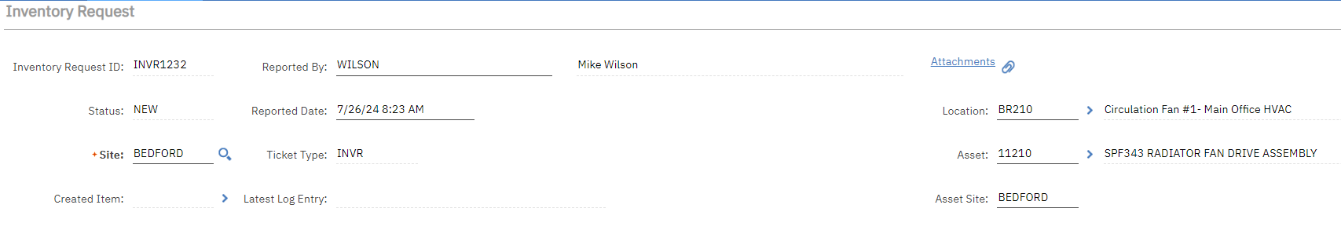
Configure the INVRMULTI application
The header information stays the same as the original single item application
Notes:
and facilitates it in companies that have a large number of suppliers where the procurement service would have to send a huge number of emails, make numerous phone calls, compare prices, etc. Thus, the Client visits the supplier’s portal via Maximo, makes a purchase electronically and all data are entered into Maximo.

Slide 10
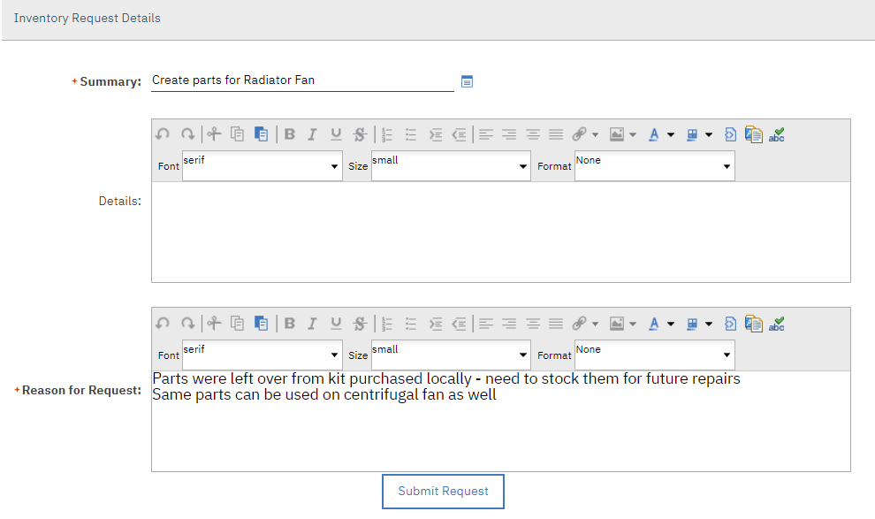
Configure the INVRMULTI application
The details Section remains
the same as the original
application.
The SUBMIT button will
remain in the same spot,
but will submit the
new workflow when it
is created.
Notes:
and facilitates it in companies that have a large number of suppliers where the procurement service would have to send a huge number of emails, make numerous phone calls, compare prices, etc. Thus, the Client visits the supplier’s portal via Maximo, makes a purchase electronically and all data are entered into Maximo.

Slide 11
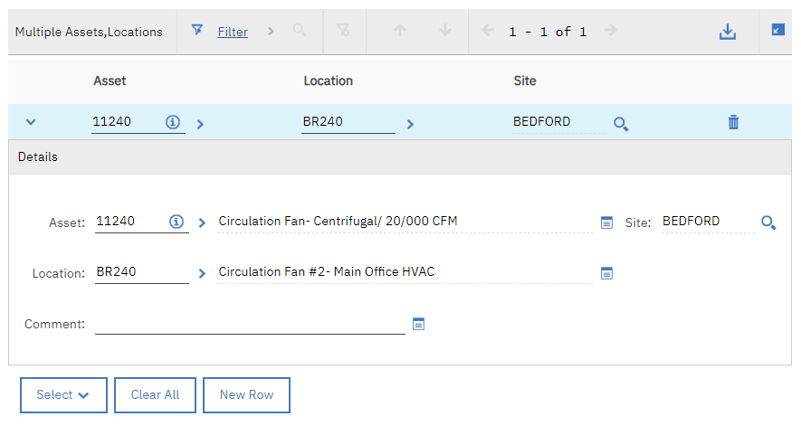
Configure the INVRMULTI application
The Multiple Assets and Locations table will remain the same as the original application
Note: The business decision was that all items on this multi line inventory request would be spare parts on whichever assets are listed.
Notes:
and facilitates it in companies that have a large number of suppliers where the procurement service would have to send a huge number of emails, make numerous phone calls, compare prices, etc. Thus, the Client visits the supplier’s portal via Maximo, makes a purchase electronically and all data are entered into Maximo.

Slide 12
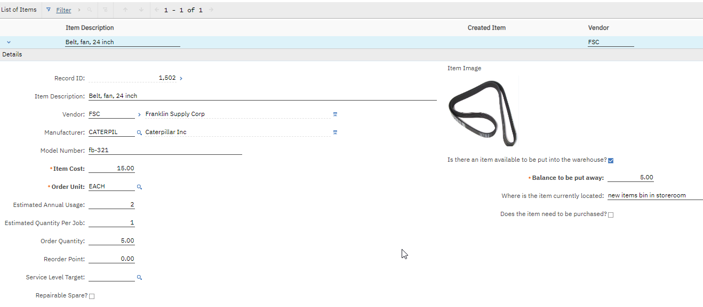
Configure the INVRMULTI application
This is the new part of the application, where the list of items comes from the data stored in the new table which is created
Notes:
and facilitates it in companies that have a large number of suppliers where the procurement service would have to send a huge number of emails, make numerous phone calls, compare prices, etc. Thus, the Client visits the supplier’s portal via Maximo, makes a purchase electronically and all data are entered into Maximo.

Slide 13
Allowing Different Item Images
In the new multi line application there is a need for the user to be able to add different item images for each line item.
The way the IMGLIB functions work in Maximo there can only be a single IMGLIB record for the parent object. In other words, since the header details are using the SR object, there could only be a single picture for each multiline inventory request.
For this reason, we created a new application which would allow the user to create an IMGLIB record for each item on the multiline request.
Notes:
and facilitates it in companies that have a large number of suppliers where the procurement service would have to send a huge number of emails, make numerous phone calls, compare prices, etc. Thus, the Client visits the supplier’s portal via Maximo, makes a purchase electronically and all data are entered into Maximo.

Slide 14
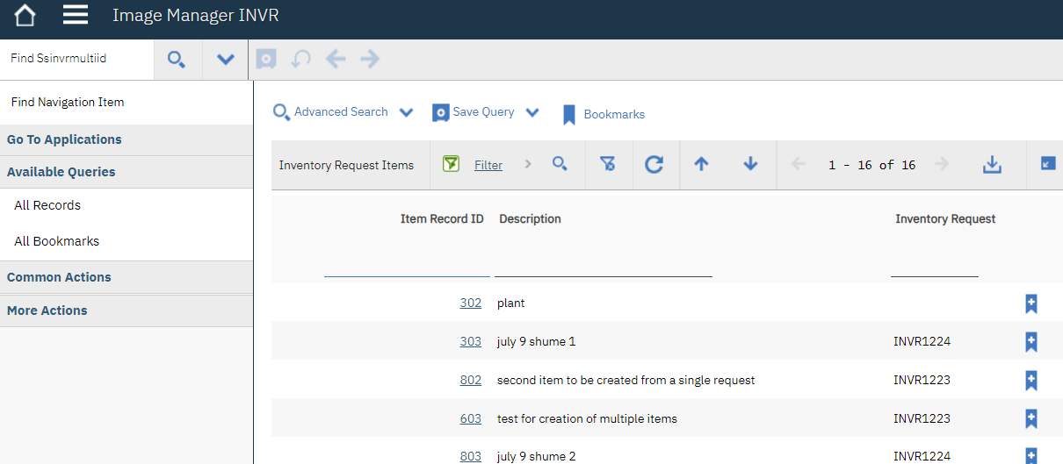
Create Second New Application
In order to allow for the addition of images for each line item, a new application must be created to manage the images for multiple line items. The reason for this is that using IMGLIB only permits a single image per record.
Notes:
and facilitates it in companies that have a large number of suppliers where the procurement service would have to send a huge number of emails, make numerous phone calls, compare prices, etc. Thus, the Client visits the supplier’s portal via Maximo, makes a purchase electronically and all data are entered into Maximo.

Slide 15
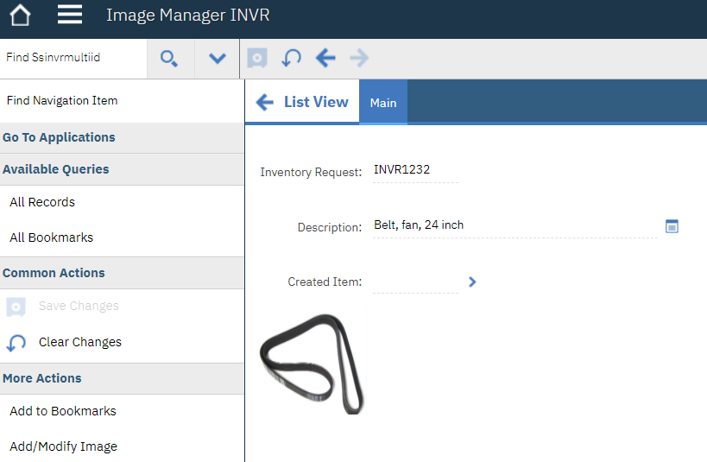
Create Second New Application
This application allows a user to scroll through all of the items on all inventory requests and can add images to each item as required. The multiple inventory request application is also configured to navigate to the image management application directly from each line item.
The application is very simple with one function only.
The user can add or modify the image that is associated with each inventory request item.
As per the standards for IMGLIB only GIF and JPG files may be used for item images.
Notes:
and facilitates it in companies that have a large number of suppliers where the procurement service would have to send a huge number of emails, make numerous phone calls, compare prices, etc. Thus, the Client visits the supplier’s portal via Maximo, makes a purchase electronically and all data are entered into Maximo.

Slide 16
Create Second New Application
List of signature options for the new Image Manager application
Option | Description
BMXVIEWMANAGEWHER | Sigoption to control the visibility of the Detail section in View/Manage Queries dialog
BMXVIEWMANAGEWHERRO | Sigoption to control the editability of the Clause field in View/Manage Queries dialog
BOOKMARK | Add to Bookmarks
CLEAR | Clear Changes
ITEMIMAGE | Add/Modify Image
NEXT | Next Item
PREVIOUS | Previous Item
READ | Read Access to Item Images
SAVE | Save Changes
SEARCHBOOK | Bookmarks
SEARCHMORE | More Search Fields
SEARCHSQRY | Save Current Query
SEARCHTIPS | View Search Tips
SEARCHVMQR | View/Manage Queries
SEARCHWHER | Where Clause
SHOWDELETE | Show Delete Button
Notes:
and facilitates it in companies that have a large number of suppliers where the procurement service would have to send a huge number of emails, make numerous phone calls, compare prices, etc. Thus, the Client visits the supplier’s portal via Maximo, makes a purchase electronically and all data are entered into Maximo.

Slide 17

Added Navigation in the INVRMULTI Application
When a new line item is added to the multi-line inventory request and the record is SAVED, the user can then use the
navigation ellipse to go to the Image Manager application to add the item image.
When they are finished adding the image they can return from there directly to the inventory request they were
working on.
Note: The new image will not be displayed in the inventory request unless the user goes to the list tab, refreshes and goes back into the inventory request.
Notes:
and facilitates it in companies that have a large number of suppliers where the procurement service would have to send a huge number of emails, make numerous phone calls, compare prices, etc. Thus, the Client visits the supplier’s portal via Maximo, makes a purchase electronically and all data are entered into Maximo.

Slide 18
New Automation Scripts
SSSETMULTIINVR –
Sets and Clears Multi INVR Fields
Automation script with attribute
launch point.
Language: Python
Launchpoint: SSMUTLINVR_ITEMAVAIL
MULTIINVR – SSITEMAVAIL
Object: SSINVRMULTI
Attribute: SSITEMAVAIL
Events: Validate
"""
Created by: Sheffield Scientific
This script performs the following functions:
If item available is unchecked the current balance is set to null
"""
# Imports
from psdi.app.common import DateUtility
from psdi.mbo import MboConstants
from psdi.server import MXServer
# Initialise variables
attributename = mbovalue.getName()
if attributename == "SSITEMAVAIL":
avail = mbo.getInt("SSITEMAVAIL")
if avail == 0:
mbo.setValue("SS_CURBAL",'', MboConstants.NOACTION and MboConstants.NOACCESSCHECK)
Notes:
and facilitates it in companies that have a large number of suppliers where the procurement service would have to send a huge number of emails, make numerous phone calls, compare prices, etc. Thus, the Client visits the supplier’s portal via Maximo, makes a purchase electronically and all data are entered into Maximo.

Slide 19
New Automation Scripts
PART 1 OF SCRIPT
SSCRITMULTI –
Create Multiple Items from Inventory
Request Automation script with action
launch point.
Language: Python
Launchpoint: SSCRITMULTI
Create Multiple Items from
Inventory Request
Action: SSCRITMULTI
# -----------------------------------------------------------------------------------------
# Author: Scheffield Scientific
# Creation Date: July 2024
# Description: To create multiple ITEMS from SR
# -----------------------------------------------------------------------------------------
from psdi.mbo import MboConstants
from psdi.server import MXServer
from org.apache.axiom.om.util import Base64
def copyItemIMG(newitemid,invrmultiid):
# if there is an image linked to the item on the inventory request copy it to the newly created item master
newimgSet = mbo.getMboSet("NEWIMGLIB")
storedynclause1 = "refobject = 'SSINVRMULTI' and refobjectid = "+str(invrmultiid)+" "
imglibSet = mbo.getMboSet("$ss_imglibset","IMGLIB",storedynclause1)
imgMbo = imglibSet.moveFirst()
while imgMbo is not None:
itemimg = newimgSet.add()
itemimg.setValue("REFOBJECT","ITEM")
itemimg.setValue("REFOBJECTID",newitemid)
itemimg.setValue("MIMETYPE",imgMbo.getString("MIMETYPE"))
itemimg.setValue("IMAGENAME",imgMbo.getString("IMAGENAME"))
itemimg.setValue("IMAGE",imgMbo.getBytes("IMAGE"))
itemimg.setValue("ENDPOINTNAME",imgMbo.getString("ENDPOINTNAME"))
itemimg.setValue("IMGURI",imgMbo.getString("IMGURI"))
imgMbo = imglibSet.moveNext()
# end of image copy
Notes:
and facilitates it in companies that have a large number of suppliers where the procurement service would have to send a huge number of emails, make numerous phone calls, compare prices, etc. Thus, the Client visits the supplier’s portal via Maximo, makes a purchase electronically and all data are entered into Maximo.

Slide 20
New Automation Scripts
SSCRITMULTI –
Create Multiple Items from Inventory Request
Automation script with action launch point.
Language: Python
Launchpoint: SSCRITMULTI Create Multiple Items from Inventory Request
Action: SSCRITMULTI
PART 2 OF SCRIPT
def createAssetparts(newitemnum):
# if there is a single asset on the inventory request create the spare part for it
assetnum = mbo.getString("ASSETNUM")
assetsite = mbo.getString("ASSETSITEID")
if assetnum != "":
org = mbo.getString("ORGID")
site = assetsite
sparepartSet = mbo.getMboSet("SSSPAREPART")
sparepart = sparepartSet.add(2L)
sparepart.setValue("ASSETNUM",assetnum,MboConstants.NOACCESSCHECK|MboConstants.NOVALIDATION)
sparepart.setValue("ITEMNUM",newitemnum,MboConstants.NOACCESSCHECK|MboConstants.NOVALIDATION)
sparepart.setValue("ITEMSETID","SET1",MboConstants.NOACCESSCHECK|MboConstants.NOVALIDATION)
sparepart.setValue("ORGID",org,MboConstants.NOACCESSCHECK|MboConstants.NOVALIDATION)
sparepart.setValue("SITEID",site,MboConstants.NOACCESSCHECK|MboConstants.NOVALIDATION)
Notes:
and facilitates it in companies that have a large number of suppliers where the procurement service would have to send a huge number of emails, make numerous phone calls, compare prices, etc. Thus, the Client visits the supplier’s portal via Maximo, makes a purchase electronically and all data are entered into Maximo.

Slide 21
New Automation Scripts
SSCRITMULTI –
Create Multiple Items from Inventory Request Automation script with action launch point.
Language: Python
Launchpoint: SSCRITMULTI Create Multiple Items from Inventory Request
Action: SSCRITMULTI
PART 3 OF SCRIPT
# if there is list of multiple assets on the inventory request add the item created to each of the assets spare parts list
assetlistSet = mbo.getMboSet("MULTIASSETLOCCI")
assetlistMbo = assetlistSet.moveFirst()
while assetlistMbo is not None:
if (not assetlistMbo.isNull("ASSETNUM")):
assetNum = assetlistMbo.getString("ASSETNUM")
org = assetlistMbo.getString("ORGID")
site = assetlistMbo.getString("SITEID")
sparepartlistSet = mbo.getMboSet("SSSPAREPART")
sparepartlist = sparepartlistSet.add(2L)
sparepartlist.setValue("ASSETNUM",assetNum,MboConstants.NOACCESSCHECK|MboConstants.NOVALIDATION)
sparepartlist.setValue("ITEMNUM",newitemnum,MboConstants.NOACCESSCHECK|MboConstants.NOVALIDATION)
sparepartlist.setValue("ITEMSETID","SET1",MboConstants.NOACCESSCHECK|MboConstants.NOVALIDATION)
sparepartlist.setValue("ORGID",org,MboConstants.NOACCESSCHECK|MboConstants.NOVALIDATION)
sparepartlist.setValue("SITEID",site,MboConstants.NOACCESSCHECK|MboConstants.NOVALIDATION)
assetlistMbo = assetlistSet.moveNext()
Notes:
and facilitates it in companies that have a large number of suppliers where the procurement service would have to send a huge number of emails, make numerous phone calls, compare prices, etc. Thus, the Client visits the supplier’s portal via Maximo, makes a purchase electronically and all data are entered into Maximo.

Slide 22
New Automation Scripts
PART 4 OF SCRIPT
SSCRITMULTI –
Create Multiple Items from Inventory Request
Automation script with action launch point.
Language: Python
Launchpoint: SSCRITMULTI Create Multiple Items from Inventory Request
Action: SSCRITMULTI
# process the list of items
multiitemSet = mbo.getMboSet("SSINVRMULTI")
multiitemMbo = multiitemSet.moveFirst()
while multiitemMbo is not None:
dynclause = " itemnum = '10000' "
itemset = mbo.getMboSet("$ss_critemset","ITEM",dynclause)
site = mbo.getString("SITEID")
orgz = mbo.getString("ORGID")
invrmultiid = multiitemMbo.getInt("SSINVRMULTIID")
#create the item
curItem = itemset.moveFirst()
newitem = curItem.duplicate()
newitemnum = newitem.getString("ITEMNUM")
newitemid = newitem.getString("ITEMID")
newitem.setValue("DESCRIPTION",multiitemMbo.getString("DESCRIPTION"))
newitem.setValue("ORDERUNIT",multiitemMbo.getString("SSORDERUNIT"))
newitem.setValue("ISSUEUNIT",multiitemMbo.getString("SSORDERUNIT"))
newitem.validate()
multiitemMbo.setValue("SSITEMNUM",newitem.getString("ITEMNUM"))
createAssetparts(newitemnum)
copyItemIMG(newitemid,invrmultiid)
multiitemMbo = multiitemSet.moveNext()
multiitemSet.save()
Notes:
and facilitates it in companies that have a large number of suppliers where the procurement service would have to send a huge number of emails, make numerous phone calls, compare prices, etc. Thus, the Client visits the supplier’s portal via Maximo, makes a purchase electronically and all data are entered into Maximo.

Slide 23
New Automation Scripts
SSCRINVMULT –
Create Multiple Inventory Records Automation script with action launch point.
Language: Python
Launchpoint: SSCRINVMULT Create Multiple Inventory Records
Action: SSCRINVMULT
PART 1 OF SCRIPT
# -----------------------------------------------------------------------------------------
# Author: Sheffield Scientific
# Creation Date: July 2024
# Description: To create multiple INVENTORY RECORDS from SR
# -----------------------------------------------------------------------------------------
from psdi.mbo import MboConstants
from psdi.server import MXServer
from org.apache.axiom.om.util import Base64
# process the list of items
multiitemSet = mbo.getMboSet("SSINVRMULTI")
multiitemMbo = multiitemSet.moveFirst()
while multiitemMbo is not None:
site = mbo.getString("SITEID")
orgz = mbo.getString("ORGID")
Notes:
and facilitates it in companies that have a large number of suppliers where the procurement service would have to send a huge number of emails, make numerous phone calls, compare prices, etc. Thus, the Client visits the supplier’s portal via Maximo, makes a purchase electronically and all data are entered into Maximo.

Slide 24
New Automation Scripts
SSCRINVMULT –
Create Multiple Inventory Records
Automation script with action launch point.
Language: Python
Launchpoint: SSCRINVMULT
Create Multiple Inventory Records
Action: SSCRINVMULT
PART 2 OF SCRIPT
if multiitemMbo.isNull("SSSTOREROOM") is False:
invset = mbo.getMboSet("NEW_INVENTORY")
newInventoryMbo = invset.addAtEnd()
storerm = multiitemMbo.getString("SSSTOREROOM")
setid = "SET1"
unit = multiitemMbo.getString("SSORDERUNIT")
binn = multiitemMbo.getString("SSBINNUM")
vendor = multiitemMbo.getString("VENDOR")
manuf = multiitemMbo.getString("SSMANUFACTURER")
model = multiitemMbo.getString("SSMODELNUM")
minl = multiitemMbo.getString("SSMINLEVEL")
orderq = multiitemMbo.getString("SSORDERQTY")
lead = multiitemMbo.getString("SS_LEADTIME")
item = multiitemMbo.getString("SSITEMNUM")
curbal = multiitemMbo.getDouble("SS_CURBAL")
cost = multiitemMbo.getDouble("SSITEMCOST")
newInventoryMbo.setPropagateKeyFlag(False);
newInventoryMbo.setValue("siteid", site, 11L);
newInventoryMbo.setValue("orgid", orgz, 2L);
newInventoryMbo.setPropagateKeyFlag(True);
newInventoryMbo.setValue("location", storerm, 3L);
newInventoryMbo.setValue("itemsetid", setid, 2L);
newInventoryMbo.setValue("itemnum", item, 3L);
newInventoryMbo.setValue("orderunit", unit, 3L);
newInventoryMbo.setValue("issueunit", unit, 2L);
newInventoryMbo.setFieldFlag("conditioncode", 7L, True);
newInventoryMbo.setFieldFlag("condrate", 7L, True);
Notes:
and facilitates it in companies that have a large number of suppliers where the procurement service would have to send a huge number of emails, make numerous phone calls, compare prices, etc. Thus, the Client visits the supplier’s portal via Maximo, makes a purchase electronically and all data are entered into Maximo.

Slide 25
New Automation Scripts
SSCRINVMULT –
Create Multiple Inventory Records Automation script with action launch point.
Language: Python
Launchpoint: SSCRINVMULT Create Multiple Inventory Records
Action: SSCRINVMULT
PART 3 OF SCRIPT
itemOrgInfoSet = newInventoryMbo.getMboSet("ITEMORGINFO");
if ((itemOrgInfoSet.isEmpty()) is False) :
newInventoryMbo.setValue("status", itemOrgInfoSet.getMbo(0).getString("status"), 3L);
itemOrgInfoSet.cleanup();
newInventoryMbo.setCostType();
newInventoryMbo.setValue("BINNUM",binn)
newInventoryMbo.setValue("VENDOR",vendor)
newInventoryMbo.setValue("MANUFACTURER",manuf)
newInventoryMbo.setValue("MODELNUM",model)
newInventoryMbo.setValue("MINLEVEL",minl)
newInventoryMbo.setValue("ORDERQTY",orderq)
newInventoryMbo.setValue("DELIVERYTIME",lead)
newInventoryMbo.validate()
invset.save()
Notes:
and facilitates it in companies that have a large number of suppliers where the procurement service would have to send a huge number of emails, make numerous phone calls, compare prices, etc. Thus, the Client visits the supplier’s portal via Maximo, makes a purchase electronically and all data are entered into Maximo.

Slide 26
New Automation Scripts
SSCRINVMULT –
Create Multiple Inventory Records Automation script with action launch point.
Language: Python
Launchpoint: SSCRINVMULT Create Multiple Inventory Records
Action: SSCRINVMULT
PART 4 OF SCRIPT
#setup inventory cost
storedynclause = "itemnum = '"+item+"' and itemsetid = 'SET1' and location ='"+storerm+"'and siteid = '"+site+"'"
invcostSet = mbo.getMboSet("$ss_invcostset","INVCOST",storedynclause)
invcost = invcostSet.moveFirst()
invcost.setValue("STDCOST",cost,MboConstants.NOACCESSCHECK|MboConstants.NOVALIDATION)
invcost.setValue("LASTCOST",cost,MboConstants.NOACCESSCHECK|MboConstants.NOVALIDATION)
#update invvendor
storedynclause = "itemnum = '"+item+"' and itemsetid = 'SET1' and siteid = '"+site+"'"
invvendorSet = mbo.getMboSet("$ss_invvendorset","INVVENDOR",storedynclause)
invvendor = invvendorSet.moveFirst()
invvendor.setValue("MODELNUM",model,MboConstants.NOACCESSCHECK|MboConstants.NOVALIDATION)
invvendor.setValue("ISDEFAULT",True,MboConstants.NOACCESSCHECK|MboConstants.NOVALIDATION)
invset.save()
Notes:
and facilitates it in companies that have a large number of suppliers where the procurement service would have to send a huge number of emails, make numerous phone calls, compare prices, etc. Thus, the Client visits the supplier’s portal via Maximo, makes a purchase electronically and all data are entered into Maximo.

Slide 27
New Automation Scripts
SSCRINVMULT – Create Multiple Inventory Records Automation script with action launch point.
Language: Python
Launchpoint: SSCRINVMULT Create Multiple Inventory Records
Action: SSCRINVMULT
PART 5 OF SCRIPT
#setup inventory balance
if curbal > 0:
invbalSet = mbo.getMboSet("SS_INVBALANCES")
invbalMbo = invbalSet.add(2L)
invbalMbo.setValue("BINNUM", binn,MboConstants.NOACCESSCHECK|MboConstants.NOVALIDATION)
invbalMbo.setValue("CURBAL", curbal,MboConstants.NOACCESSCHECK|MboConstants.NOVALIDATION)
invbalMbo.setValue("PHYSCNT", curbal,MboConstants.NOACCESSCHECK|MboConstants.NOVALIDATION)
invbalMbo.setValue("ITEMNUM", item,MboConstants.NOACCESSCHECK|MboConstants.NOVALIDATION)
invbalMbo.setValue("SITEID", site,MboConstants.NOACCESSCHECK|MboConstants.NOVALIDATION)
invbalMbo.setValue("ORGID", orgz, 2L)
invbalMbo.setValue("RECONCILED", "0", 2L)
invbalMbo.setValue("LOCATION", storerm,MboConstants.NOACCESSCHECK|MboConstants.NOVALIDATION)
invbalMbo.setValue("itemsetid", setid, 2L)
invbalSet.save()
multiitemMbo = multiitemSet.moveNext()
Notes:
and facilitates it in companies that have a large number of suppliers where the procurement service would have to send a huge number of emails, make numerous phone calls, compare prices, etc. Thus, the Client visits the supplier’s portal via Maximo, makes a purchase electronically and all data are entered into Maximo.

Slide 28
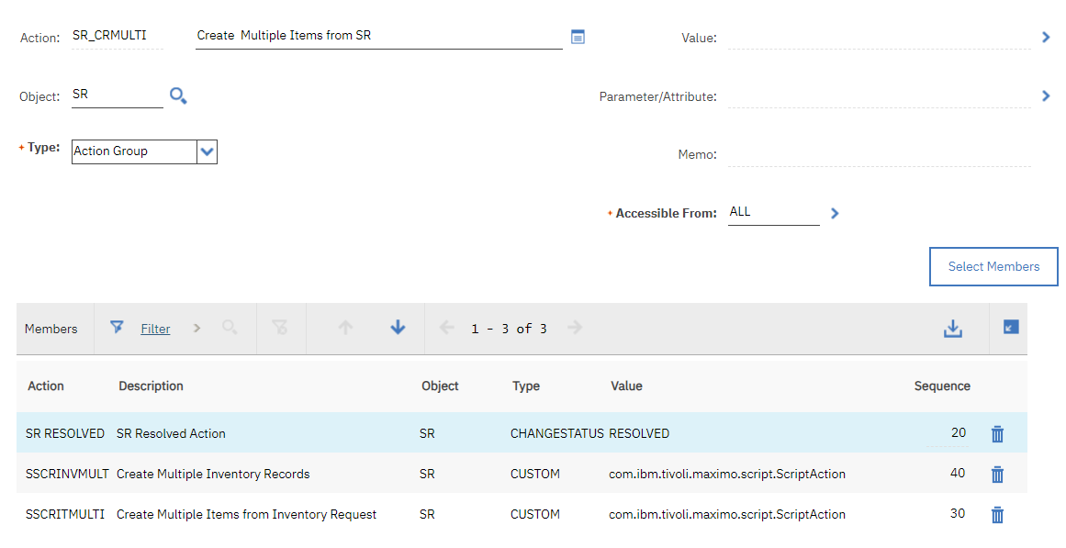
New Workflow Action Group
Notes:
and facilitates it in companies that have a large number of suppliers where the procurement service would have to send a huge number of emails, make numerous phone calls, compare prices, etc. Thus, the Client visits the supplier’s portal via Maximo, makes a purchase electronically and all data are entered into Maximo.

Slide 29
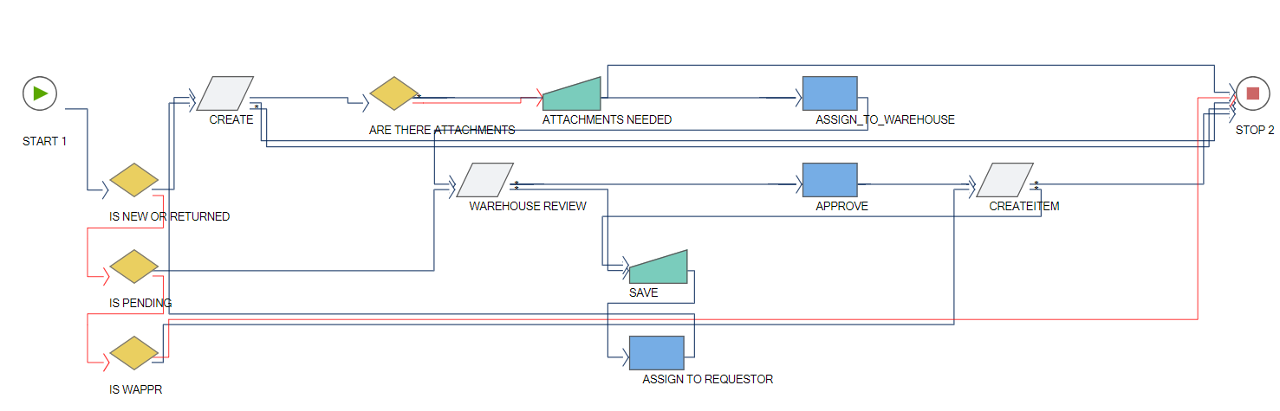
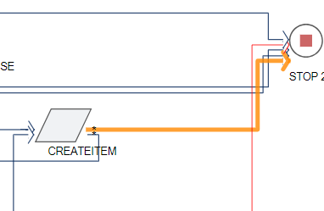
New Workflow
Notes:
and facilitates it in companies that have a large number of suppliers where the procurement service would have to send a huge number of emails, make numerous phone calls, compare prices, etc. Thus, the Client visits the supplier’s portal via Maximo, makes a purchase electronically and all data are entered into Maximo.

Slide 30
Credits and Acknowledgements
This presentation is a compilation of many great ideas and configurations in Maximo that I have
seen and used elsewhere. Many have been topics for presentations at previous MaxTECH
sesisions on their own. The purpose of today is to show how you can bring concepts together in
Maximo to make even a custom application better.
If you need any of the details on how to implement any of the features described in this presentation
drop me an email and I would be happy to provide them for you and your company.
Also note the features do not need to be limited to just this application but can be applied to any
application in Maximo. It is the skills and concepts and being creative in your configuration
which are important.
Stephen Hume
stephen.hume@sheffieldscientific.com
403 651-6117
Notes:
and facilitates it in companies that have a large number of suppliers where the procurement service would have to send a huge number of emails, make numerous phone calls, compare prices, etc. Thus, the Client visits the supplier’s portal via Maximo, makes a purchase electronically and all data are entered into Maximo.

Slide 31

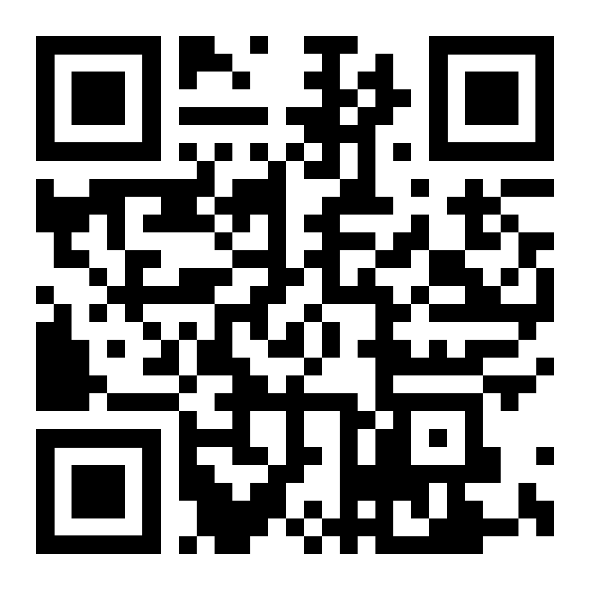
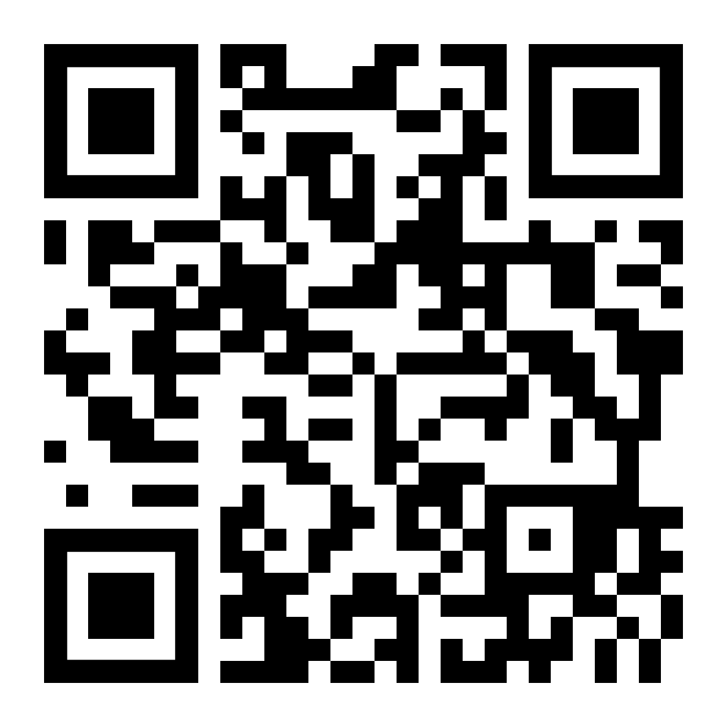


Thank you
Ask us
a technical question:
Watch
previous webinars:
Thank You to our Partners:
maxtech@bpdzenith.com
www.bpdzenith.com/na/maxtech/
Join our LinkedIn Group | MaxTECH – Maximo Technical User Group

